Slide 1
BU Law | Chinese and Korean Race-Based Algorithm
Team 1
Aditya Agrawal
Cindy Lu
Leon Zhang
Melissa Zhen
Sponsor
BU School of Law
Notes:
Slide 1
Project Title, Sponsor, Team Members
Project motivation:
What is the goal of the project?
What is the background needed to understand the project?

Slide 2
Progress
PM meetings and bi-weekly client meetings on Wednesdays
Questions Answered: Q1 - “What is the difference in gender analysis when analyzing characters instead of US translated names?”
Process: We first extracted the original KR/CN names from our data and used pre-existing gender guesser algorithms to perform our analysis. We decided to perform a gender analysis using only Chinese names first.
Tools used: English : Harvard Dataverse WGND then PyPI’s google_patent_scraper. Chinese : jaaack-wang/gender-predicator (Github) (trained on 3.65 million names)
Data: We used the data collected from the previous year’s Team1 and extracted their original KR/CN names.
From years 2005, 2017, 2019, 2020, and 2021
Extracted original names for patents with CN or KR inventors.
We distributed the work among us by assigning each member a year to extract data from
Notes:
Slide 2
What have you done so far? (meetings, data analysis)
How did you divide up the work among the team
What data have you used? If you collected data, how did you do that?

Slide 3
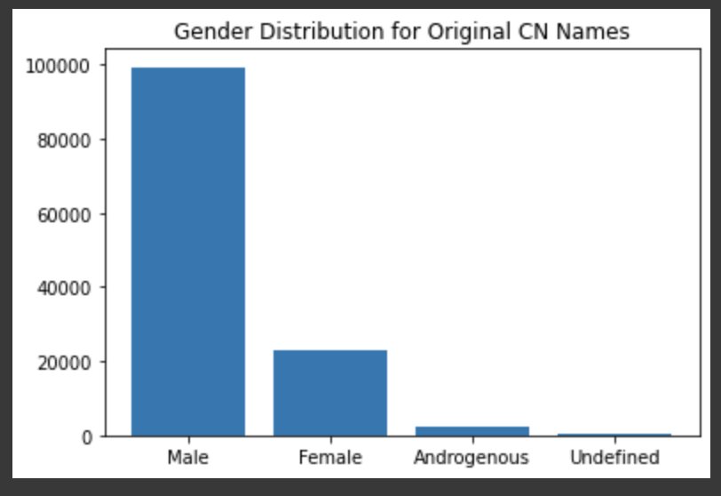
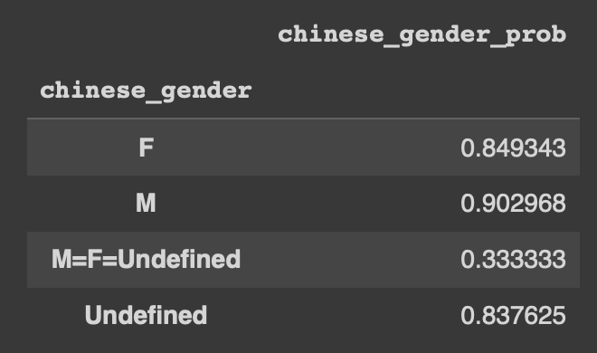
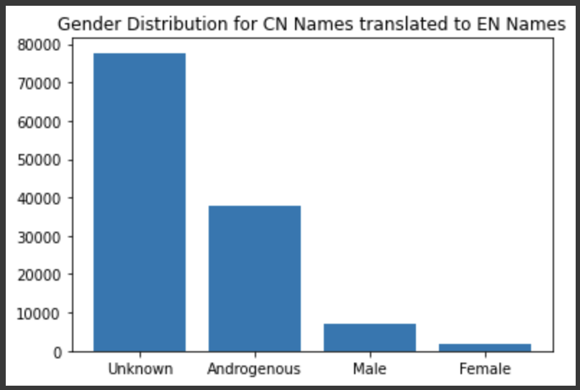
Early Observations
Observations
Early Challenges
Each year has a different number of patents in the dataset with some of the datasets being very large and taking long to process
Intermediate solution: using samples of each dataset
Notes:
Slide 3
What (early) results or observations do you have?
What (early) visualizations can you show?
What challenges did you encounter working with data?

Slide 4
Future Work
Challenges and limitations
Large runtime to extract original names.
Not all Chinese & Korean inventors have their original characters available on websites.
A lot of gender prediction for English Names are unknown.
Next Step
We will try to develop a method to predict Korean inventor’s gender using their Korean name.
Based on our prediction on the dataset, we will do some visualization to show the gender makeup of inventors on Chinese and Korean patents.
We’ll try to find a better method to predict the gender of English names [just to confirm the comparison is legitimate]
Notes:
Slide 4
Any additional challenges you have encountered?
What limitations have you encountered? What assumptions have you had to make?
Based on the (early) results, what are the expected next steps?
What are you planning to do to complete your project?

